Slide 1
UNDP’s Earthquake Response
Insights and Pathways to Enhanced Recovery
Arzu Karaarslan Azizoğlu, Local Economic Development Projects Coordinator at UNDP Türkiye

Slide 2
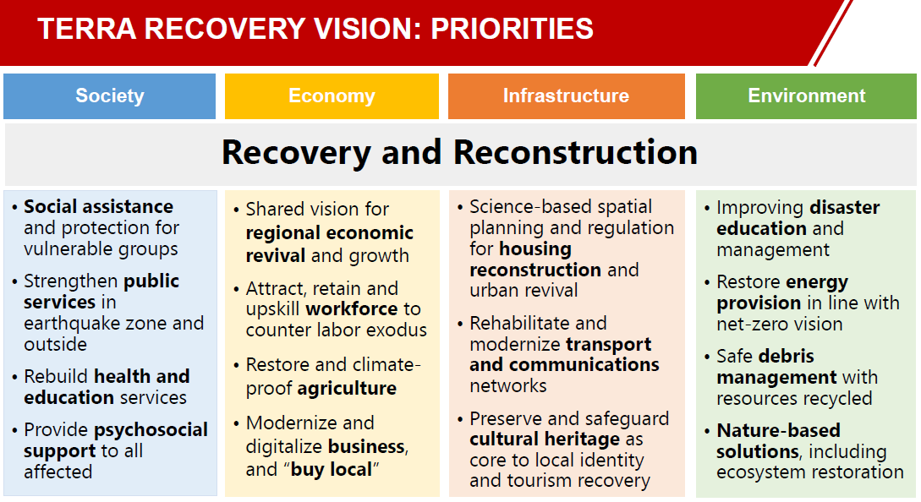
Priorities for Recovery

Slide 3
UNDP’s Recovery Activities
Restoring care services for vulnerable groups
Improving management of waste and earthquake debris
Restoring livelihoods and reviving business activity
Protecting endangered cultural heritage

Slide 4
Key Elements
Presence and Knowledge of the Region/Networks
In-depth understanding of the region's socio-economic, cultural, and political dynamics.
Extensive network connections with local stakeholders, including government agencies, NGOs, and community leaders.
Profound knowledge of the region's history, challenges, and opportunities.
Ability to leverage local networks for informed decision-making and resource allocation.
Being Agile and Responsive:
Rapid adaptation to changing circumstances and emerging challenges.
Quick decision-making to address urgent issues and seize opportunities.
Flexible resource allocation to meet evolving needs.
Proactive problem-solving and continuous improvement in response strategies.
Human-Centered and Considering Special Groups/Needs:
Prioritizing the well-being and dignity of individuals and communities.
Tailoring solutions to meet the specific needs of vulnerable populations.
Ensuring inclusivity and equity in all interventions.
Empathy-driven approaches that address unique circumstances and perspectives.

Slide 5
Key Elements
Communication/Coordination and Cooperation at Local Level:
Effective communication channels established with local partners and stakeholders.
Seamless coordination among various organizations, agencies, and community groups.
Building trust-based relationships to enhance cooperation and collaboration.
Local-level decision-making and problem-solving to empower communities.
Invest More in Prevention and Preparedness:
Allocating resources for proactive risk assessment and mitigation.
Developing comprehensive preparedness plans for various types of crises.
Investment in education and training to enhance local resilience.
Advocating for policies that prioritize prevention and early intervention.

