Slide 1
The Greek Mission of Cities: Presentation of a national action program to support Greek municipalities in promoting Climate Neutrality. The Municipality of Mytilini as a case study
Dr. P. Voulellis : Urban Planner, European Climate Pact Ambassador

Slide 2
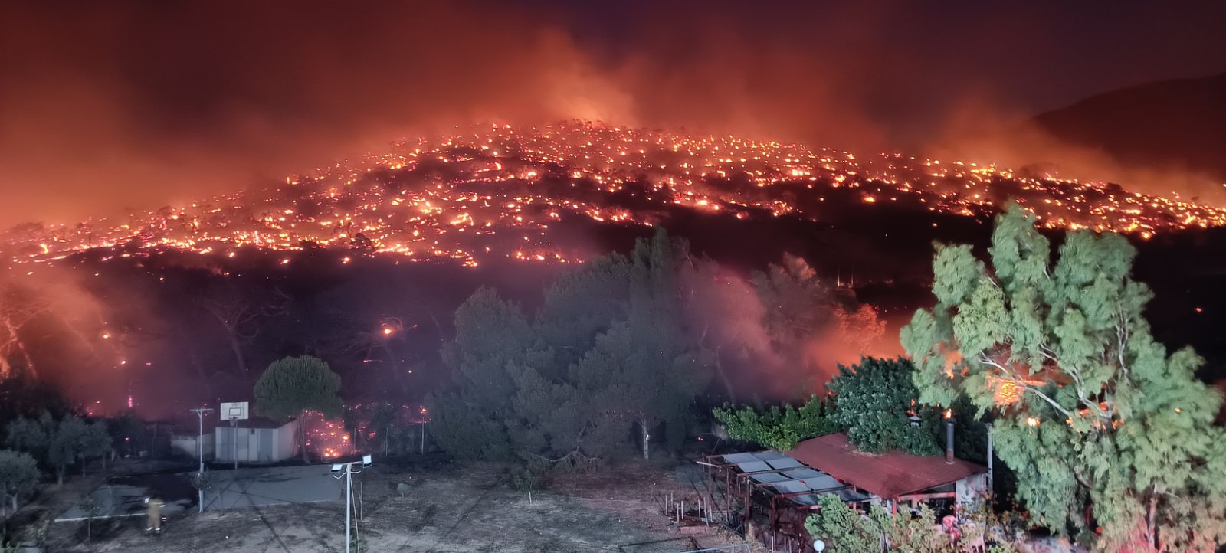
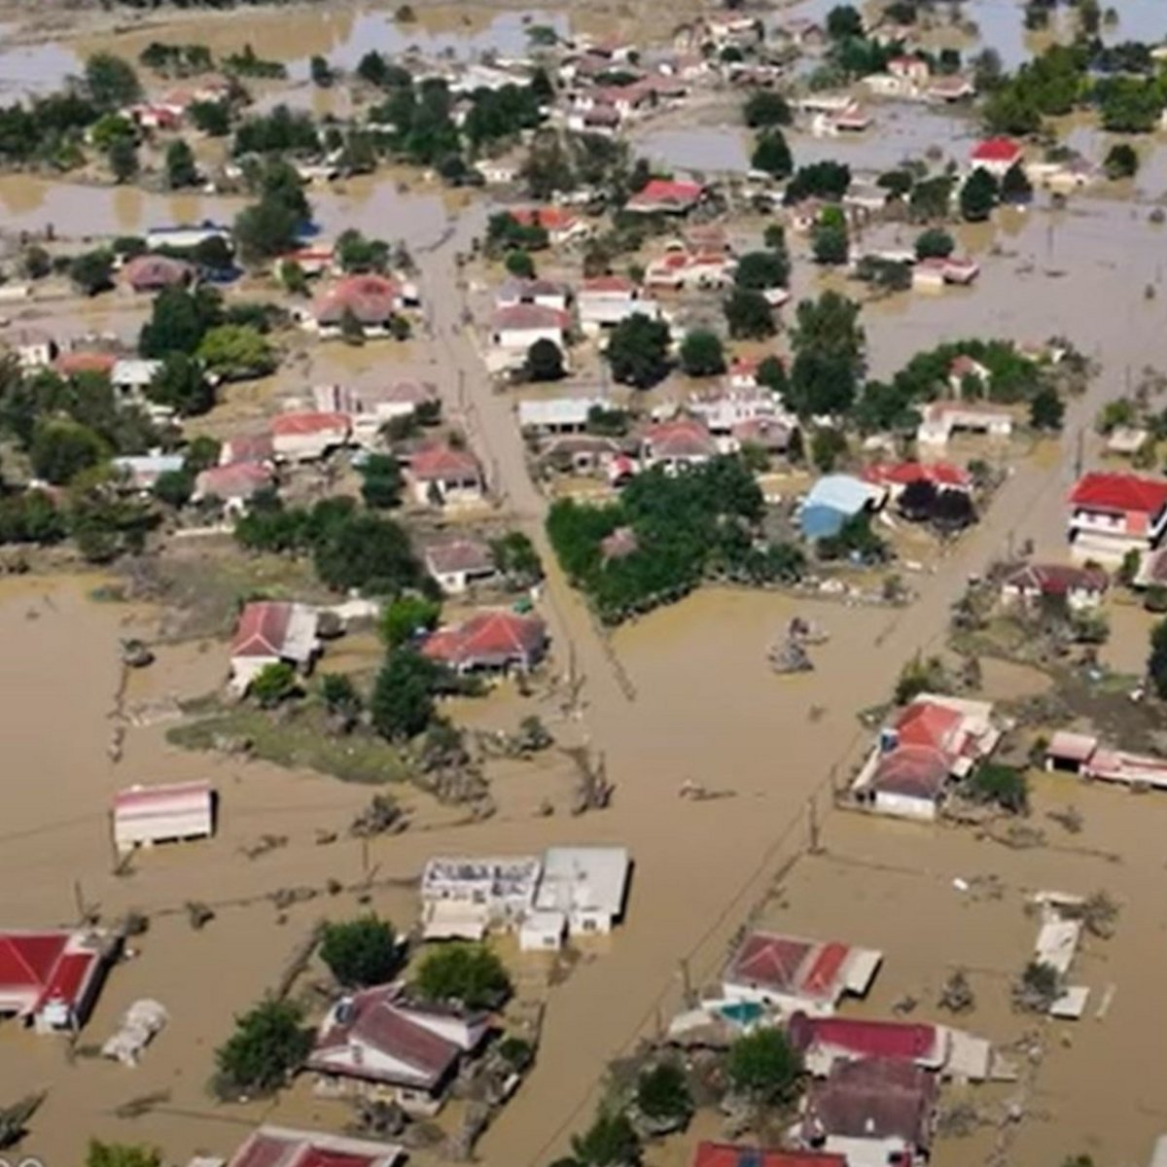
ACTION
The depletion of the ozone layer, the greenhouse effect, the decline in biodiversity, environmental degradation, the increasing pressure for greater energy and resource consumption due to a growing population, and the stark inequalities in resource consumption between wealthy and impoverished nations constitute the most pressing global environmental challenges. Addressing these issues is particularly difficult.
The promotion of both Sustainable Development and Climate Neutrality, in accordance with the United Nations and the European Commission for Cities, is an imperative pathway for the development of any spatial system. New technologies and applications serve as fundamental enablers in this endeavor.
CRISIS

Slide 3
“The goals of the European Green Deal are ambitious and crucial in tackling the urgent issue of climate change”
The first goal is to reduce greenhouse gas emissions by 55% by 2030.
The second goal is for Europe to become the world's first climate-neutral continent by 2050.
However, achieving these goals is impossible without cities serving as a reference point for achieving climate neutrality. Therefore, cities play a critical role in helping Europe achieve its climate goals."
Mobilizing local authorities, citizens, businesses, investors, as well as universities, research institutions, and regional and national authorities is essential in achieving the goals of the European Green Deal.
1
By 2030, the European Green Deal aims to establish 100 climate-neutral and smart cities. These cities will serve as models for others to follow, demonstrating that it is possible to achieve sustainable urban development while reducing greenhouse gas emissions and creating a high quality of life for citizens.
“Eu Cities Mission”
2
The 100 cities will serve as experimental and innovative hubs, paving the way for all European cities to follow their example and achieve the goal of becoming climate-neutral by 2050. Through their leadership, these cities will help to accelerate the transition towards a sustainable future and inspire others to take action.
3
100 climate-neutral and smart cities

Slide 4
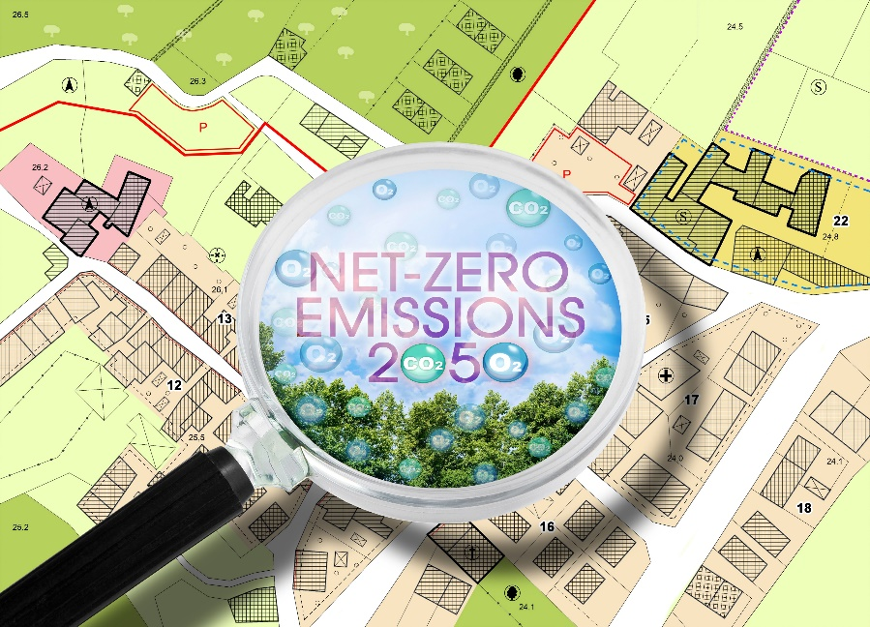
What does the transition to climate neutrality mean for a city?
radical changes in many areas of the urban environment
participatory planning
holistic approach that includes costed and necessary actions in energy, mobility, waste, construction, as well as in the municipality's structure, legislation, public finance, and more. To achieve the goal of climate neutrality, a dynamic transition timeline must be established, and there is a need for close collaboration between local authorities, research institutions, and the private sector
establishment of a Transition Team comprising of experts and the Municipal Authority
The process involves consultation, action identification, evaluation, implementation, and monitoring
A key component of the Mission for Cities is a political commitment by the Municipal Authority to engage citizens and stakeholders in the process.
«the Mission for Cities is not a common funding program for municipalities. Rather, it is a comprehensive and integrated approach to promoting sustainable urban development, bringing together different stakeholders to work towards a shared vision and goals for the future of our cities. Through this collaborative effort, we can drive innovation and achieve tangible results in the transition towards a climate-neutral and sustainable urban environment»
100 climate-neutral and smart cities

Slide 5
NATIONAL INITIATIVE
NATIONAL STRATEGY FOR ADAPTATIONON CLIMATE CHANGE
National Climate Law– ν. 4936/2022
Invitation to the Municipalities of the Country and coordination by the General Secretariat of Spatial Planning and Urban Environment of the Ministry of the Interior for the submission of an application to participate in the European Mission
3.2.2023 : A memorandum of cooperation was signed within the framework of the Greek Cities Mission, by 90 Greek Municipalities with the Ministry of Environment and Energy

Slide 6
Signing of MoU of 90 Municipalities
90 Greek Municipalities (> 50% of the Greek Population)
Areas of action
Areas of cooperation
Α. Actions to strengthen the common Goal
development of mechanisms for better cooperation
promoting climate-friendly policies
cooperation with the goal of transitioning to a climate-neutral and smart future
Β. Strengthening the institutional capacity of collective environmental and self-governing bodies. Dealing with obstacles
research and mapping of problems that are an embankment in achieving the goal
mapping of public mechanisms and procedures for the implementation of environmental actions
preparation of action plan and investment Plan for Climate Neutrality
establishment of a temporary or permanent body or entity in order to maximize benefits
cooperation within the framework of the European Green Deal and the European Cities Mission
cooperation for the integration of the Sustainable Development Goals into local policies
Contribution and participation in projects and actions of the Cities Mission
participation in Horizon Europe funding programs incorporating and promoting the values and principles of the EU initiative for the new European Bauhaus
cooperation for the Planning and implementation of Sustainable Urban Mobility
dissemination of good practices, know-how and research results
100 climate-neutral and smart cities

Slide 7
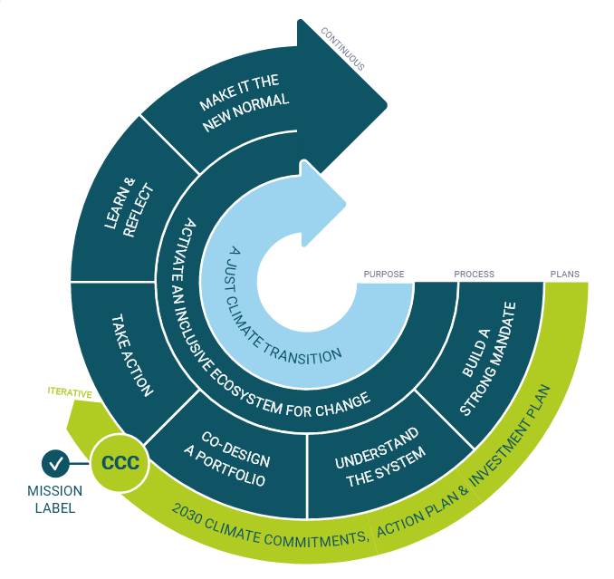
NetZeroYPEN Electronic Platform
valuable information from the European cities mission and netzerocities platform
networking opportunities for municipalities
Online Submission of Application for Participation in the Greek Program of the Cities Mission
Technical support
Presentation of Financial Tools – Opportunities
100 climate-neutral and smart cities

Slide 8
Online Submission of Application
RECORD OF STRATEGIC PLANS AND PROJECTS/ACTIONS THAT PROMOTE THE CLIMATE NEUTRALITY OF THE MUNICIPALITY AND WHICH HAVE ALREADY BEEN PARTICIPATED IN SOME FUNDING
GENERAL DETAILS OF THE MUNICIPALITY(contact details, etc.)
SPECIAL MUNICIPAL INFORMATION(Municipal units, Population, etc.)
DETERMINATION OF OBSTACLES
DESCRIPTION OF COMMUNICATION AND CONSULTATION STRUCTURE
QUANTITATIVE DETERMINATION OF THE OBJECTIVE AND TIME SCHEDULE OF THE MUNICIPALITY'S TRANSITION TO CLIMATE NEUTRALITY
100 climate-neutral and smart cities

Slide 9
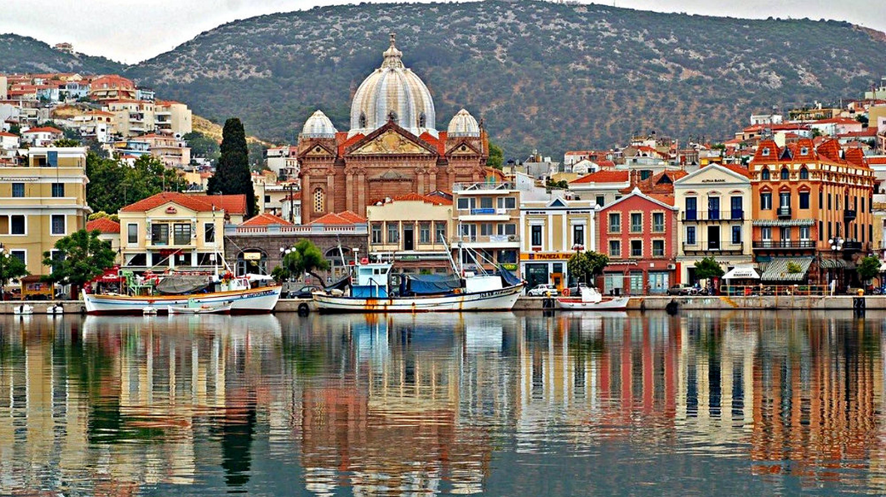
Municipality of Mytilene - A Comprehensive Case Study in Climate Neutrality
Mytilene, the historic capital of Lesbos and the North Aegean Region, is a key player in Greece's climate neutrality efforts. Established in 2019, it is one of two municipalities on the island.
Mytilene has developed a comprehensive action plan for sustainable development and climate neutrality, focusing on spatial planning, environmental balance, and waste management.
The municipality has prepared specialized plans including a Plan for Sustainable Urban Mobility (SBAK), an Urban Accessibility Plan (UAP), and an Electric Vehicle Charging Plan
In partnership with the School of Environment of the University of the Aegean, Mytilene has established effective monitoring mechanisms, including a digitized data recording system and an index list for tracking progress.
A specialized administrative structure oversees climate action, including the calculation of CO2 emission trends, scenario planning, and the installation of external measuring points for environmental monitoring.

